Slide 1
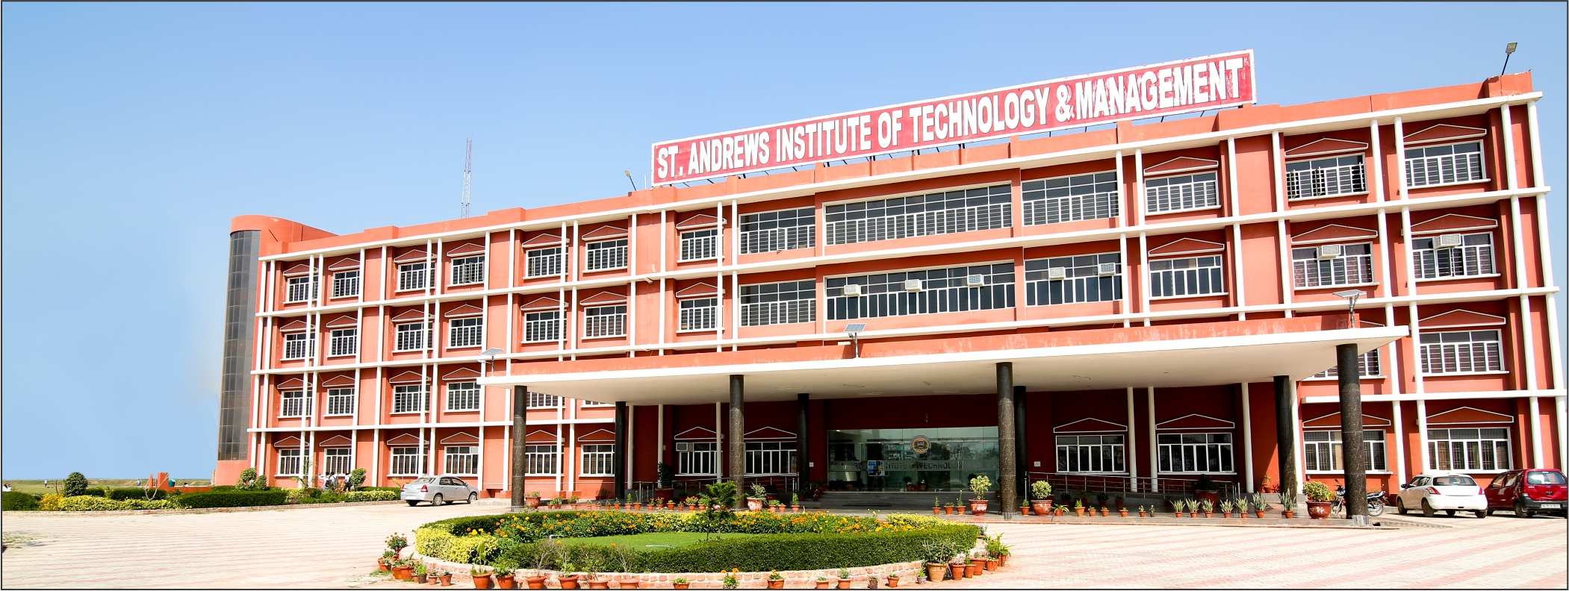

Slide 2
AGENDA
ST. ANDREWS INSTITUTE OF TECHNOLOGY AND Management
Introduction
Title
About us
Navigation bar
Dropdown MENU
Zoom effect
Login & sign in page
Footer part

Slide 3
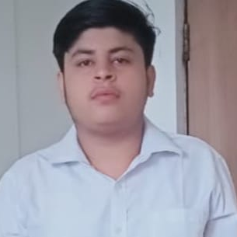
Introduction
NAME:PURAV
COURSE:BTECH
BRANCH: (CSE)
ROLL NO.:223098
GUIDED BY:GARVIT SIR

Slide 4

FLIPKART CLONE.. (Ecommerce website);
TITLE…
Designed by: Purav

Slide 5

About us..
Flipkart is an Ecommercially website like an Digital store.
This site is made only using HTML and CSS. This is an online shopping app . flip kart was founded in October 2007 by Sachine Bansal and Binny Bansal, alumni of the IIT, Delhi and former Amazon employees.

Slide 6
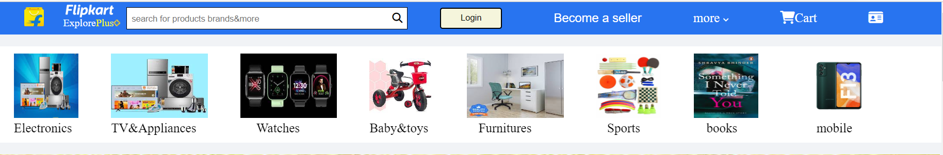
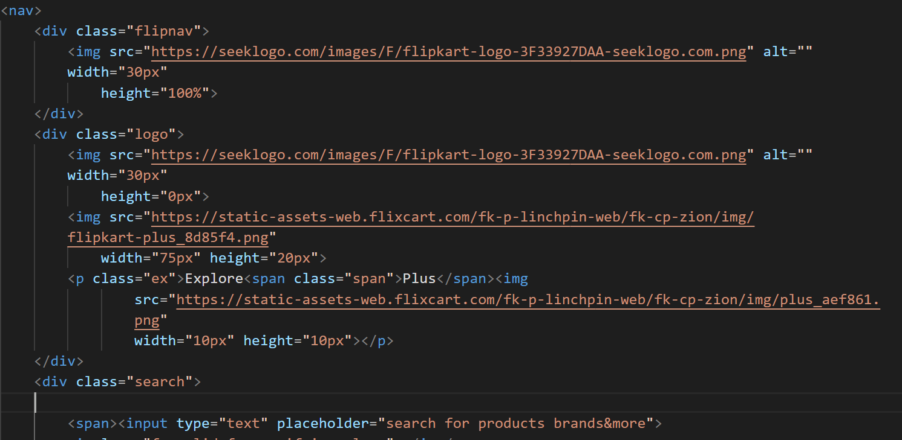
Navigation bar..

Slide 7
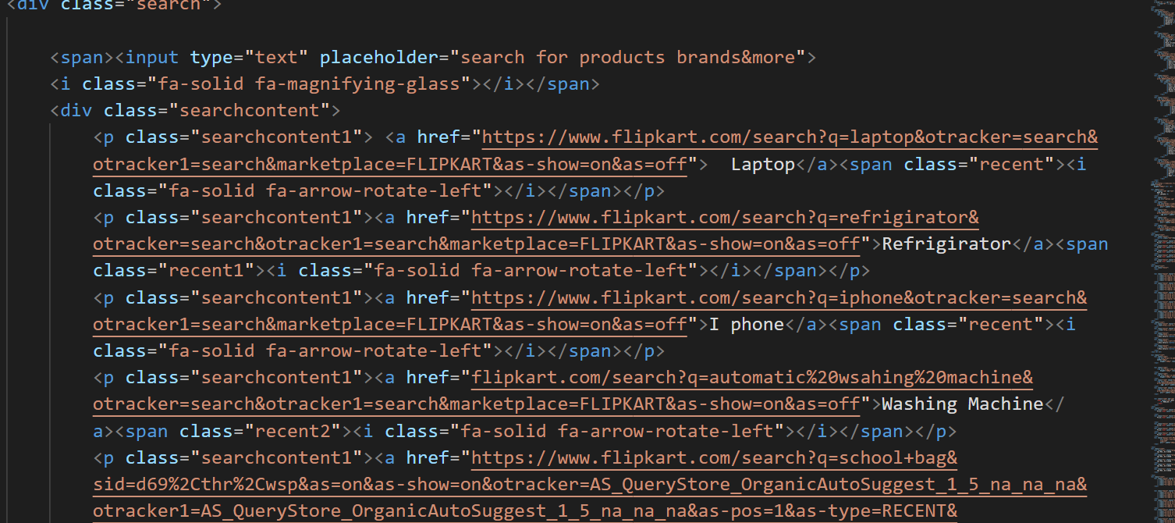
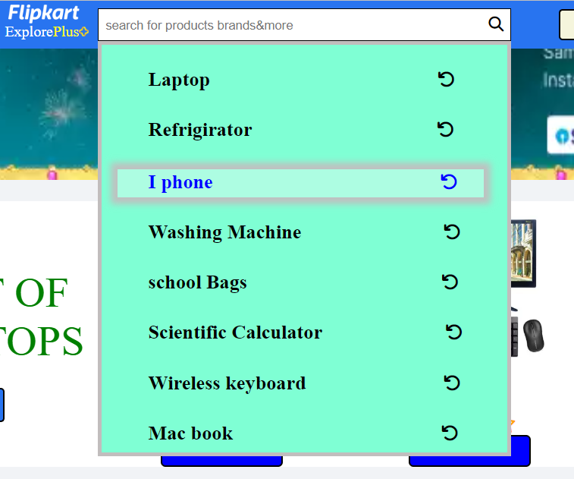
Dropdown menu..

Slide 8
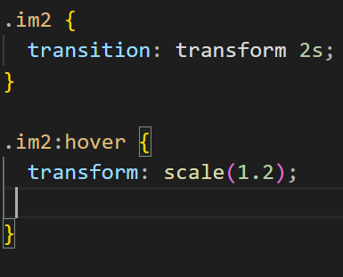
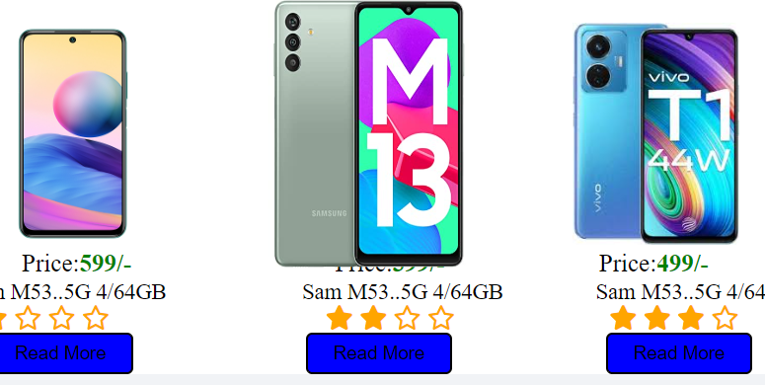
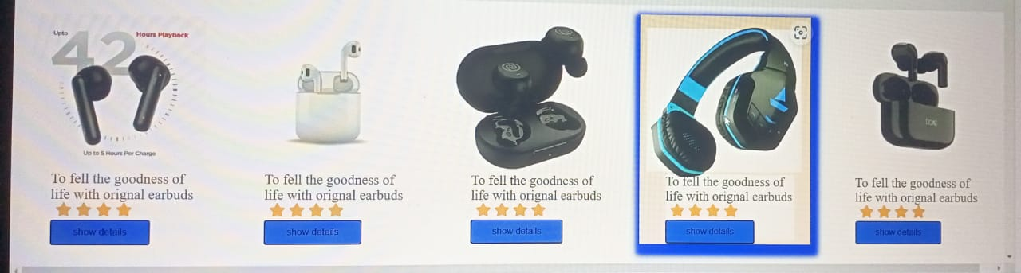
Zoom effect..

Slide 9
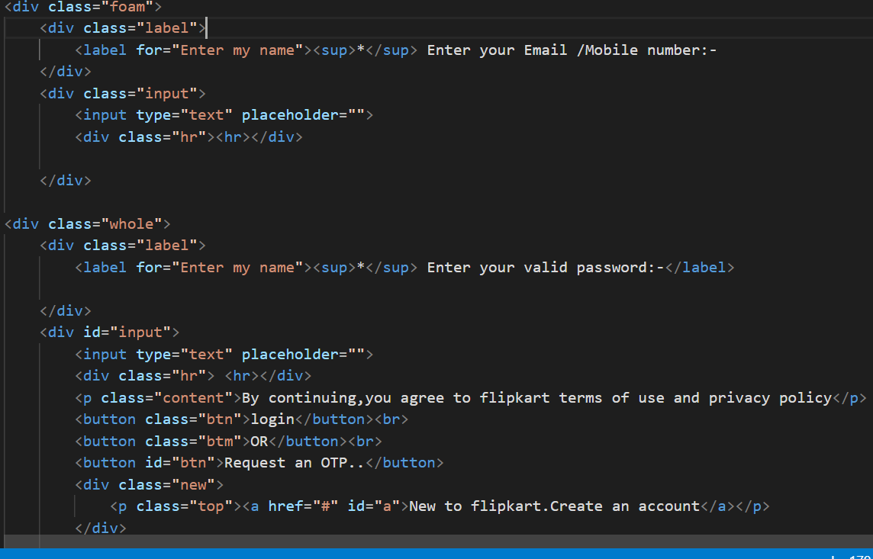
Login page..

Slide 10
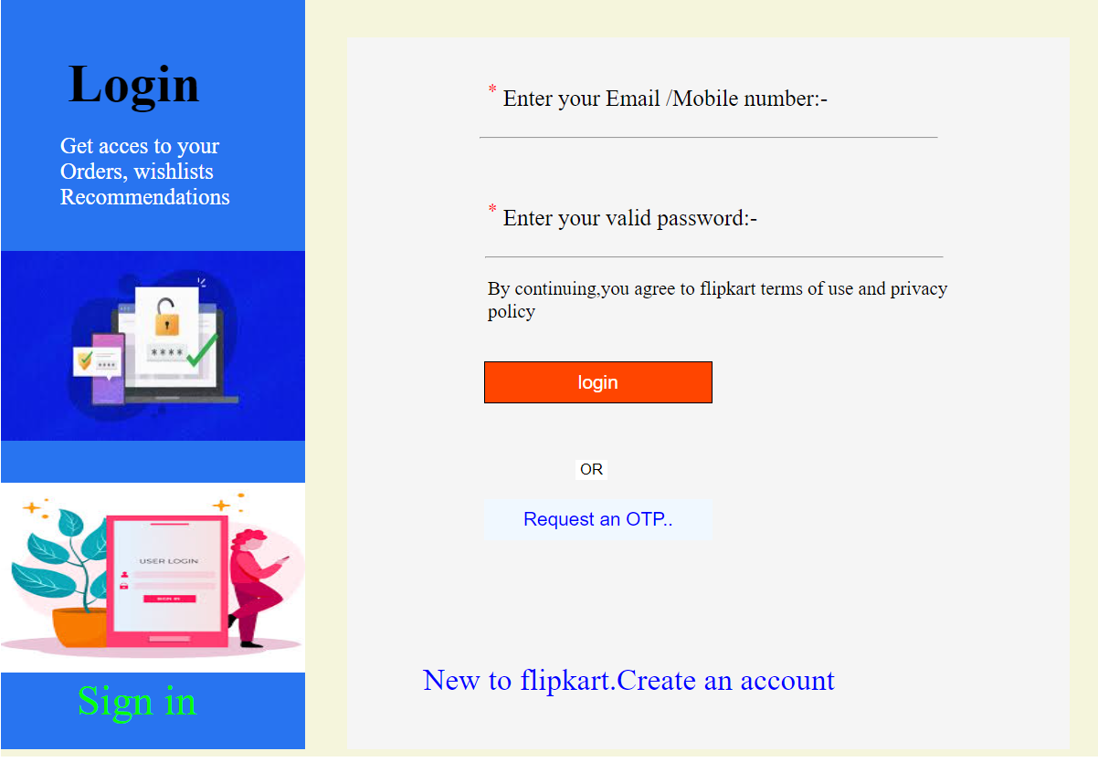

Slide 11
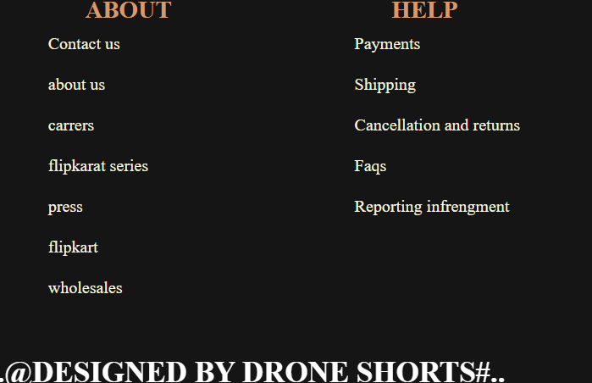
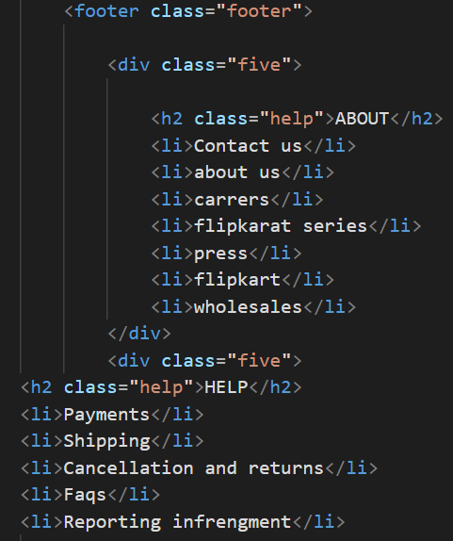
Footer page..

Slide 12


